Slide 1
Basic python

Slide 2
Basic types and data structures
Basic types
Python has a few basic data types
The command type returns the type
The command print is needed in this case because notebooks tend to print out only the last line
print(type(10))
print(type(10.0))
print(type(10+0j))
print(type("10"))
print(type(True))
<class 'int'>
<class 'float'>
<class 'complex'>
<class 'str'>
<class 'bool'>

Slide 3
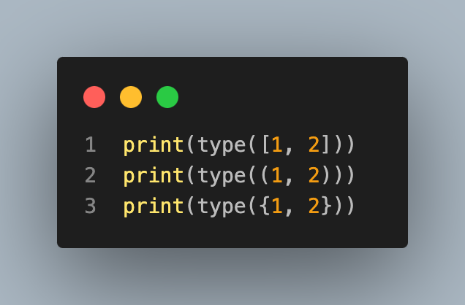
Basic data structures
Python has some core data structures, we'll cover these more later
However, here's a teaser
<class 'list'>
<class 'tuple'>
<class 'set'>

Slide 4
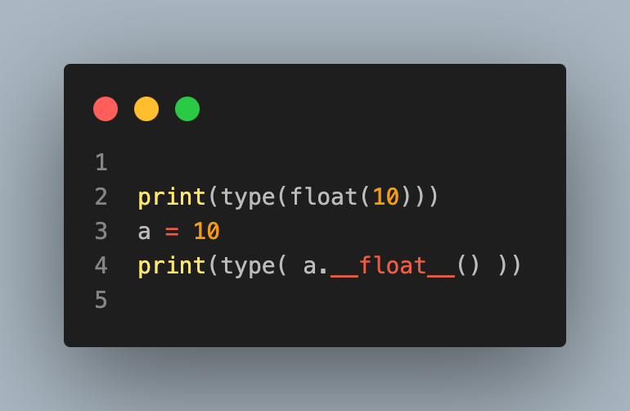
Type conversions
<class 'float’>
<class 'float'>

Slide 5
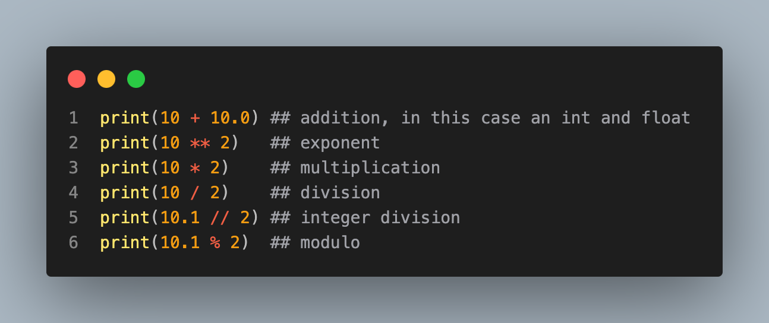
Basic operations
Python has the standard operators +, -, *, /
Exponent is **
// is integer division
% is modulo
Type conversion happen automatically if they're obvious
20.0
100
20
5.0
5.0
0.09999999999999964

Slide 6
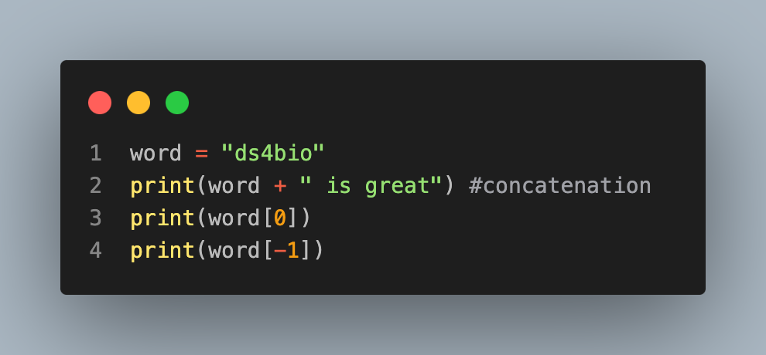
String and string operators
Strings are really easy to work with in python
Addition + becomes concatenation
Brackets can reference characters (counting from 0)
ds4bio is great
d
o

Slide 7
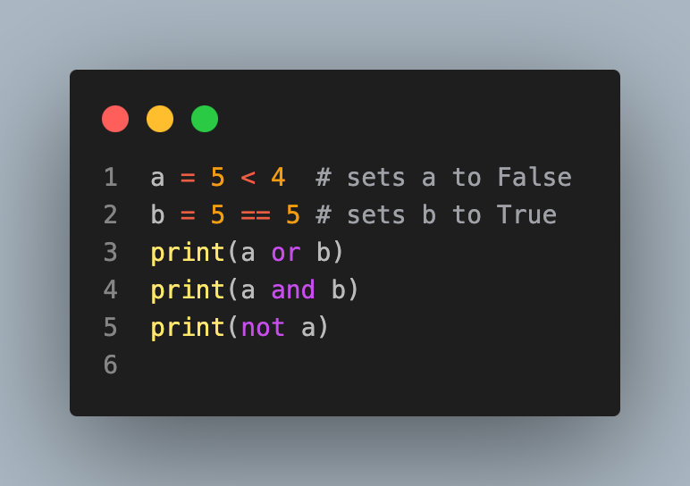
Booleans
The strings True and False are reserved
Also, bitwise logicals |, &, ~
True
False
True

Slide 8
Data structures
Python has some more advanced data structures that build on its primitive types.
Lists: ordered collections of objects
Sets: like lists but only have unique elements
Tuples: like lists, but not mutable, i.e. need to create a new one to modify
Dictionaries: named elements that you can reference by their name rather than position

Slide 9
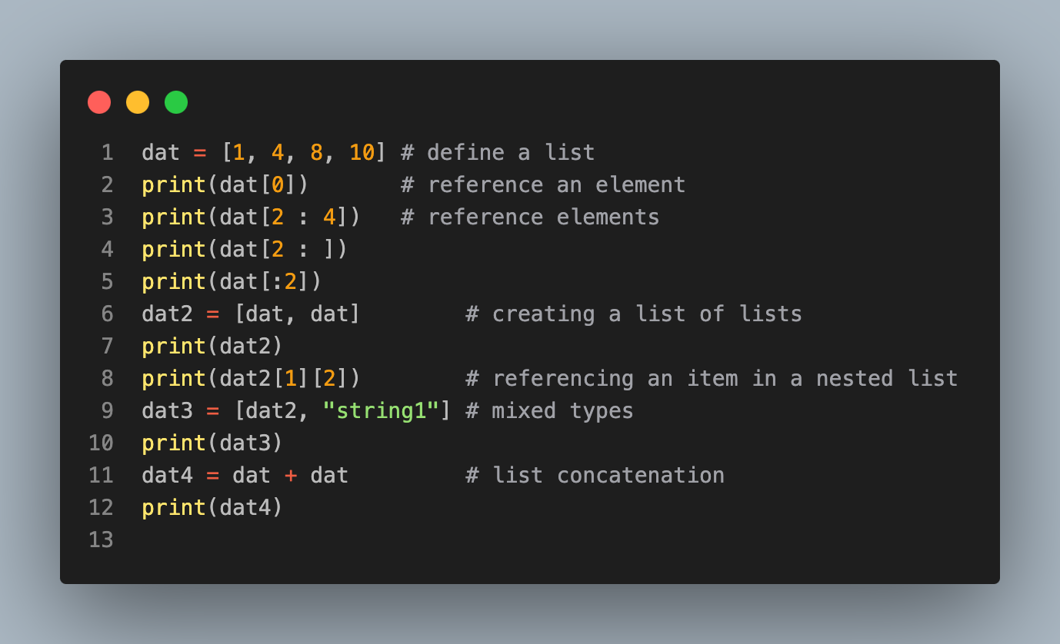
Lists
1
[8, 10]
[8, 10]
[1, 4]
[[1, 4, 8, 10], [1, 4, 8, 10]]
8
[[[1, 4, 8, 10], [1, 4, 8, 10]], 'string1’]
[1, 4, 8, 10, 1, 4, 8, 10]

Slide 10
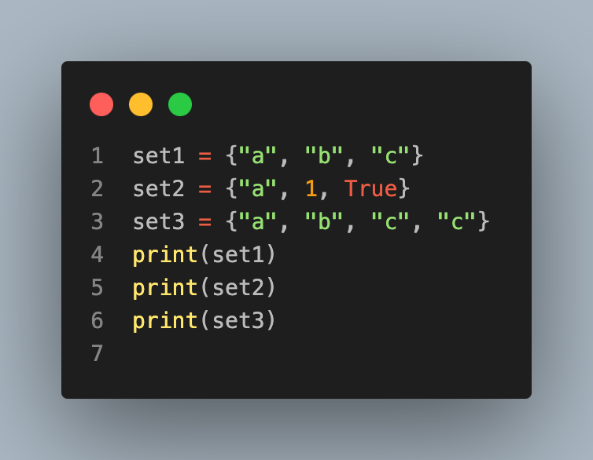
Sets
Sets can be created with curly braces
Sets only have unique values
Sets can have mixed data types
{'a', 'b', 'c'}
{1, 'a’}
{'a', 'b', 'c'}

Slide 11
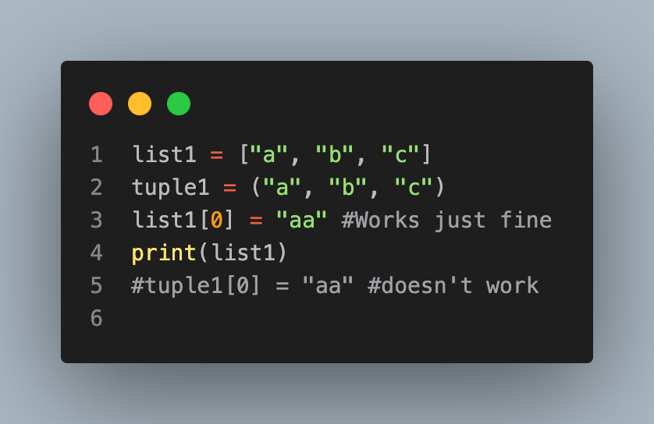
Tuples
Tuples are like lists, but immutable
Here's an example
['aa', 'b', 'c']

Slide 12
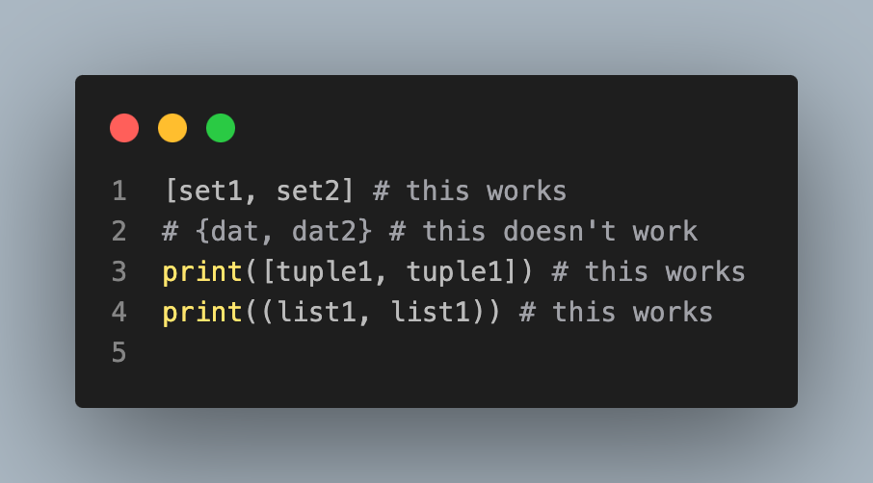
Notice
You can have a list of sets, but not a set of lists
You can have a list of tuples and a tuple of lists
[('a', 'b', 'c'), ('a', 'b', 'c’)]
(['aa', 'b', 'c'], ['aa', 'b', 'c'])

Slide 13
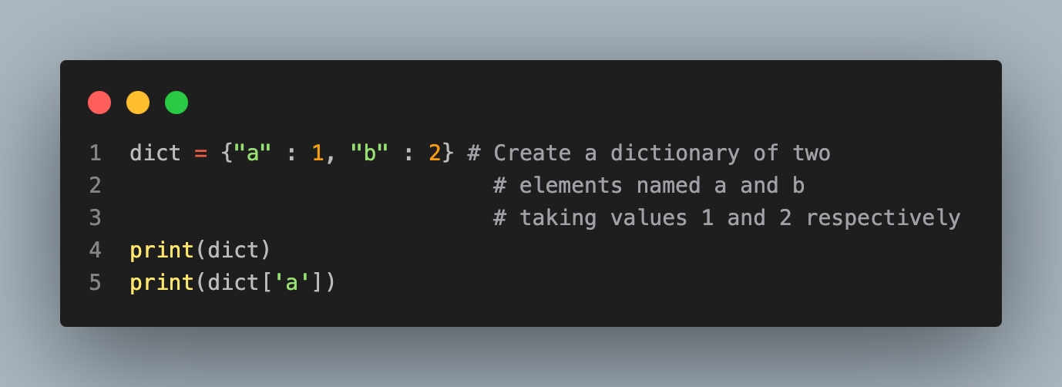
Dictionaries
Dictionaries are like lists, but with label references
Here let's create a dictionary with 2 elements, one labeled 'a' and one labeled 'b'.
We reference a dictionary label element with dictionary['label']
{'a': 1, 'b': 2}
1

Slide 14
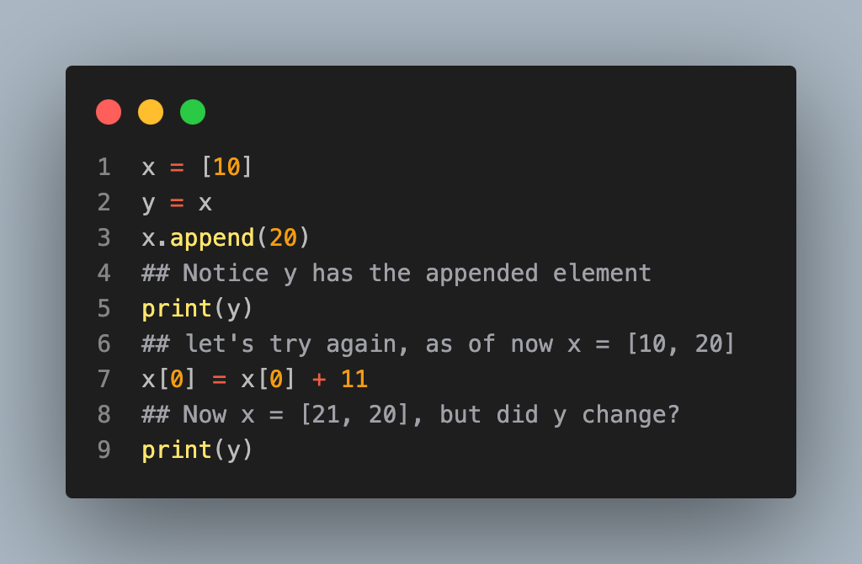
Discussion, mutable in immutable entities
When working with objects in python, mutable and immutable elements act differently. Lists are mutable. So, below, the element y gets appended along with x.
[10, 20]
[21, 20]

Slide 15
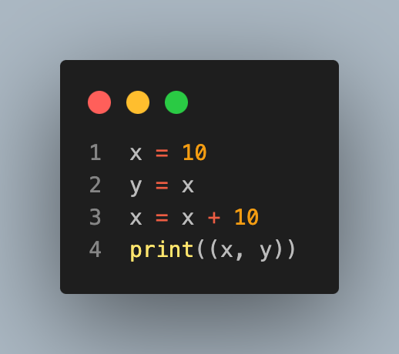
Immutable objects
Things like numbers and strings are immutable. Notice that changing y does not change x.
(20, 10)

